Slide 1

Basics of Web Design
Fifth Edition
Chapter 10
Form Basics Key Concepts
Copyright © 2025 Pearson Education, Inc. All Rights Reserved
Notes:
If this PowerPoint presentation contains mathematical equations, you may need to check that your computer has the following installed:
1) Math Type Plugin
2) Math Player (free versions available)
3) NVDA Reader (free versions available)

Slide 2
Learning Outcomes
Describe common uses of forms on web pages
Create forms on web pages using the form, input, textarea, and select elements
Associate form controls and groups using label, fieldset, and legend elements
Use C S S to style a form
Use Grid Layout to style a form
Describe the features and common uses of server-side processing
Invoke server-side processing to handle form data
Configure new H T M L 5 form controls and attributes

Slide 3
Overview of Forms
Forms are used all over the Web to
  Accept information
  Provide interactivity
Types of forms:
  Search form, Order form, Newsletter sign-up form, Survey form, Add to Cart form, and so on…

Slide 4
Form Definition
HTML form facilitates the user to enter data that is to be sent to the server for processing such as name, email address, password, phone number, etc.
Contains:
controls such as text fields, password fields, checkboxes, radio buttons, submit button, menus etc.
www.Javapoint.com

Slide 5
Two Components of Using Forms
The web page form
An H T M L element that contains and organizes form controls such as text boxes, check boxes, and buttons that can accept information from website visitors.
and
The server-side processing
Server-side processing works with the form data and sends e-mail, writes to a text file, updates a database, or performs some other type of processing on the server.

Slide 6
Form Attributes
The <form> element supports several attributes that control its behavior:
action: Specifies the URL of the file that will process the form data when submitted.
If omitted, the data is sent to the current page.
target: Defines where the response from submitting the form will be displayed.
Common values include _blank (new window/tab), _self (current window/tab, default), _parent, _top, or a specific framename.
method: Determines the HTTP method used to send the form data.
  get: Appends form data to the URL as name/value pairs.
  This is visible in the URL and has size limitations. Never use for sensitive data.
  post: Sends form data in the body of the HTTP request.
  This method is more secure, has no size limitations, and the data isn't visible in the URL.
autocomplete: Controls whether the browser should automatically complete values based on user's past entries (on or off).
novalidate: A boolean attribute that, when present, prevents the form data from being validated upon submission.
name: Specifies a name for the form.

Slide 7
Form Elements
HTML forms are built using various elements to gather different types of input:
<input>: The most versatile form element, used to create various input fields depending on its type attribute
(e.g., text, password, submit, radio buttons, checkboxes).
<label>: Defines a caption for a form element. It improves accessibility by associating text with input fields,
especially for screen readers and users who struggle with small clickable areas.
<select>: Creates a drop-down list from which users can choose one or multiple options.
  <option>: Defines an individual option within a <select> drop-down list.
  <optgroup>: Groups related options in a drop-down list.
<textarea>: Defines a multi-line text input field, useful for longer text entries like comments or messages.
<button>: Defines a clickable button, which can be used to submit forms, reset forms, or trigger JavaScript functions.
<fieldset>: Used to group related form elements together, visually creating a box around them.
<legend>: Provides a caption or title for the content within a <fieldset> element.
<datalist>: Specifies a list of pre-defined options for an <input> element, offering suggestions to the user as they type.
<output>: Represents the result of a calculation or user action within a form.

Slide 8
Input Types
HTML forms are essential for collecting user input on websites.
They allow users to interact with the site by entering text, selecting options,
uploading files, and more. The data collected is then typically sent to a server for processing.
The <input> element's type attribute determines the kind of input control it displays:
text: A single-line text input field.
password: A single-line input field where characters are masked (shown as asterisks or circles).
submit: A button for submitting the form data.
reset: A button that resets all form values to their default.
radio: Allows a user to select only one option from a limited set of choices.
checkbox: Allows a user to select zero or more options from a limited set of choices.
button: A clickable button that can trigger JavaScript.
color: A field for inputting a color, often displaying a color picker.
date: A field for selecting a date, often displaying a date picker.
datetime-local: A field for selecting a date and time (without time zone).
email: A field for entering an email address, with built-in validation for email format.
file: A field and "Browse" button for uploading files.
hidden: A non-visible input field used to store data that needs to be submitted with the form but not seen or modified by the user. Not for security.
image: An image that functions as a submit button.

Slide 9
Input Types continue…
month: A field for selecting a month and year.
number: A field for entering a numerical value.
range: A slider control for entering a number within a specified range where the exact value isn't critical.
search: A text field specifically designed for search queries.
tel: A field for entering a telephone number.
time: A field for selecting a time (without time zone).
url: A field for entering a URL, with built-in validation for URL format.
week: A field for selecting a week and year.

Slide 10
Input Types Attributes
Beyond the type attribute, <input> elements can have additional attributes to control their behavior and add restrictions:
checked: Specifies that a checkbox or radio button should be pre-selected when the page loads.
disabled: Makes an input field unusable and unclickable.
max: Specifies the maximum value allowed for numeric or date inputs.
maxlength: Specifies the maximum number of characters allowed for text input.
min: Specifies the minimum value allowed for numeric or date inputs.
readonly: Makes an input field uneditable by the user.
required: Specifies that the input field must be filled out before submitting the form.
size: Specifies the visible width of the input field in characters.
step: Specifies the legal number intervals for numeric or range inputs.
value: Specifies the default value for an input field.
name: Crucially important, this attribute provides the name for the input field,
which is used to identify the data when it's submitted to the server. If omitted, the input field's value won't be sent.
id: A unique identifier for the input element, often used with the <label> element's for attribute to associate them.

Slide 11
Form-Specific Attributes
These attributes override the corresponding attributes of the parent <form> element for a specific input:
form: Specifies the ID of the <form> element the <input> belongs to,
especially useful if the input is outside the <form> tags.
formaction: Specifies the URL of the file that will process the input when the form is submitted,
overriding the form's action attribute. Works with submit and image types.
overriding the form's enctype attribute. Works with submit and image types.
formmethod: Defines the HTTP method for sending form data, overriding the form's method attribute.
Works with submit and image types.
formtarget: Specifies where to display the response after submitting the form,
overriding the form's target attribute. Works with submit and image types.
formnovalidate: Specifies that this particular input element should not be validated when submitted,
overriding the form's novalidate attribute. Works with submit type.

Slide 12
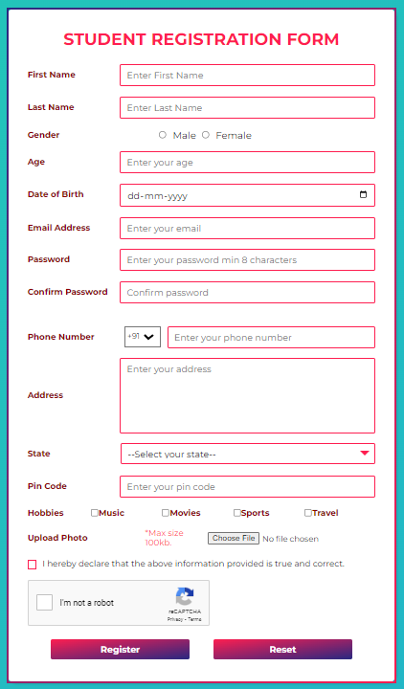
Sample form

Slide 13
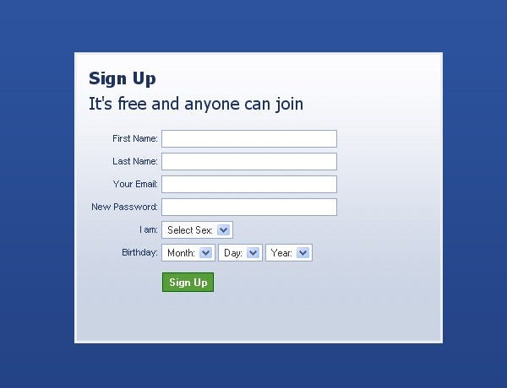
Facebook Registration form

Slide 14
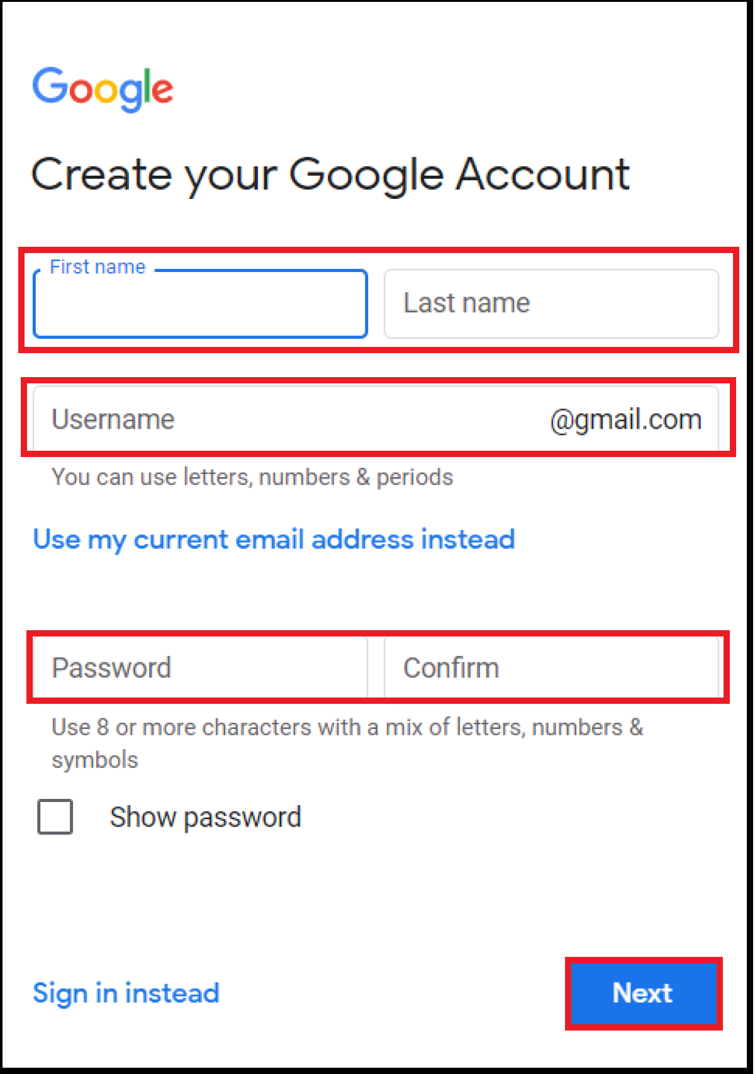
Gmail Registration form

Slide 15
H T M L Using Forms
<form> tag
  Contains the form elements on a web page
  Container tag
<input> tag
  Configures a variety of form elements including text boxes, radio buttons, check boxes, and buttons
  Stand alone tag
<textarea> tag
  Configures a scrolling text box
  Container tag
<select> tag
  Configures a select box (drop down list)
  Container tag
<option> tag
  Configures an option in the select box
  Container tag

Slide 16
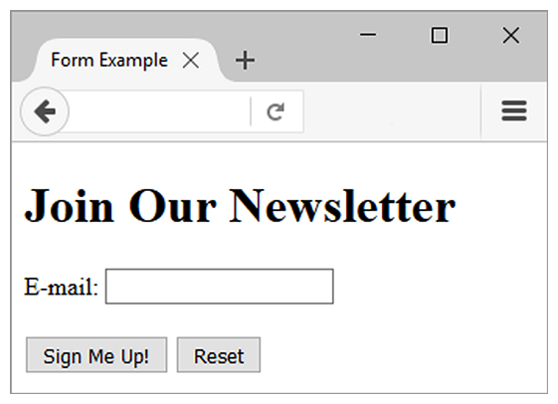
Sample Form H T M L
<form>
E-mail: <input type="text" name="email" id="email" >
<br><br>
<input type="submit" value="Sign Me Up!"> <input type="reset">
</form>

Slide 17
The Form Element <form>
Container Tag
The form element attributes:
  action
    Specifies the server-side program or script that will process your form data
  method
    get – default value, form data passed in U R L
    post – more secure, form data passed in H T T P Entity Body
  name
    Identifies the form
  id
    Identifies the form

Slide 18
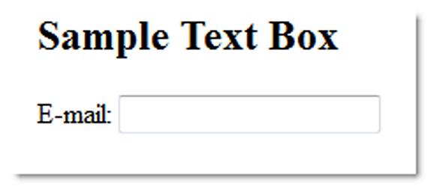
The Input Element Text Box <input>
Accepts text information
Common Attributes:
  type="text"
  name
  id
  size
  maxlength
  value
  required (H T M L 5)
  placeholder (H T M L 5)

Slide 19
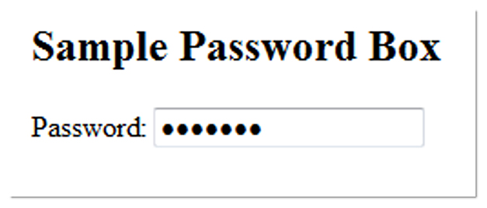
The Input Element Password Box <input>
Accepts text information that needs to be hidden as it is entered
Common Attributes:
  type="password"
  name
  id
  size
  maxlength
  value
  required (H T M L 5)
  placeholder (H T M L 5)

Slide 20
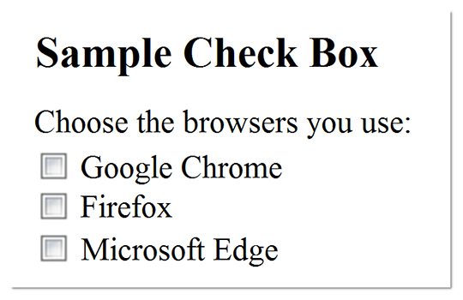
The Input Element Check box <input>
Allows the user to select one or more of a group of predetermined items
Common Attributes:
  type="checkbox"
  name
  id
  checked
  value

Slide 21
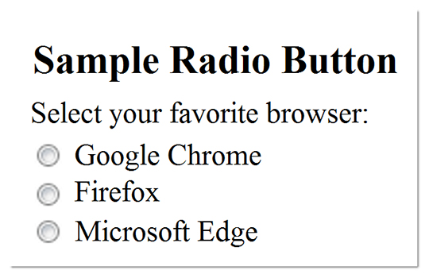
The Input Element Radio Button <input>
Allows the user to select exactly one from a group of predetermined items
Each radio button in a group is given the same name and a unique value
Common Attributes:
  type="radio"
  name
  id
  checked
  value

Slide 22
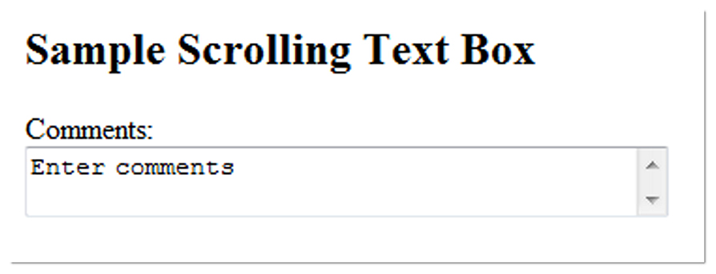
The Textarea Element <textarea>
Configures a scrolling text box
Common Attributes:
  name
  id
  cols
  rows

Slide 23
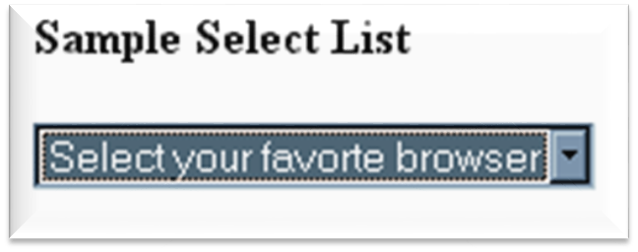
The Select Element <select>
Configures a select list (along with <option> tags)
Also known as: Select Box, Drop-Down List, Drop-Down Box, and Option Box.
Allows the user to select one or more items from a list of predetermined choices.
Common Attributes:
  name
  id
  size
  multiple

Slide 24
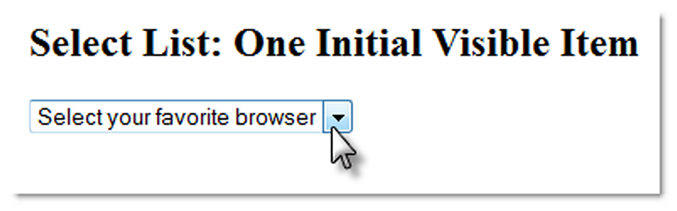
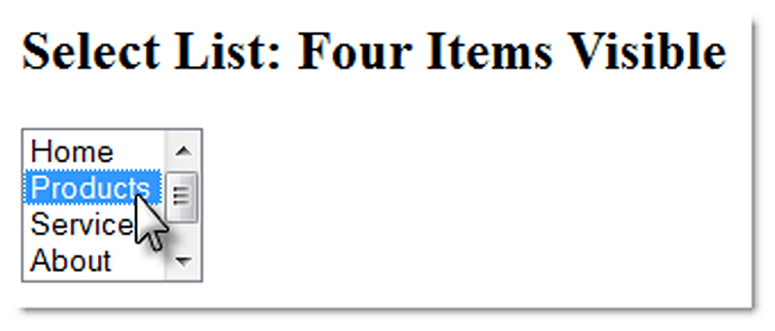
The Option Element <option>
Configures the options in a Select List
Attributes:
  value
  selected

Slide 25
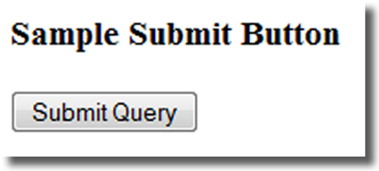
The Input Element Submit Button <input>
Submits the form information
When clicked:
  Triggers the action method on the <form> tag
  Sends the form data (the name=value pair for each form element) to the web server.
Attributes:
  type="submit"
  name
  id
  value

Slide 26
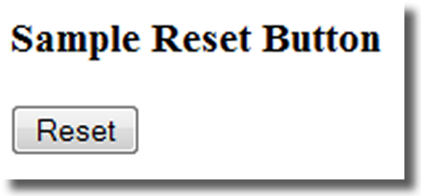
The Input Element Reset Button <input>
Resets the form fields to their initial values
Attributes:
  type="reset"
  name
  id
  value

Slide 27
The Input Element Hidden Field <input>
This form control is not displayed on the Web page.
Hidden form fields
  Can be accessed by both client-side and server-side scripting
Common Attributes:
  type="hidden"
  name
  id
  value

Slide 28
The Label Element <label>
Associates a text label with a form control
Two Different Formats:
<label>Email: <input type="text" name="CustEmail"
id ="CustEmail"></label>
OR
<label for="email">Email: </label>
<input type="text" name="CustEmail" id= "email" />

Slide 29
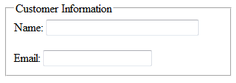
The Fieldset & Legend Elements
The Fieldset Element <fieldset>
  Container tag
  Creates a visual group of form controls on a web page
The Legend Element <legend>
  Container tag
  Creates a text label within the fieldset
<fieldset><legend>Customer Information</legend>
<label>Name:
<input type="text" name="CName" id="CName" size="30"></label>
<br><br>
<label>Email:
<input type="text" name="CEmail" id="CEmail"></label>
</fieldset>

Slide 30
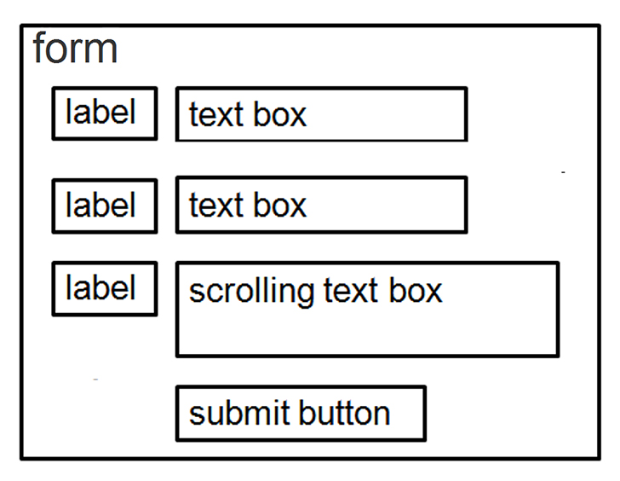
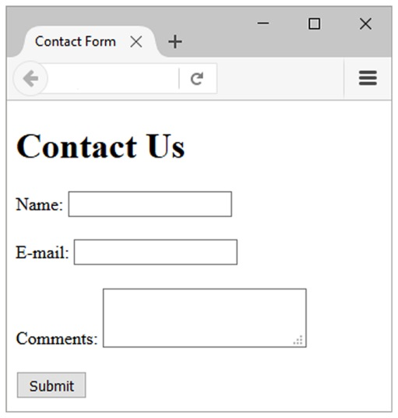
Using C S S to Style a Form
form { background-color:#e a e a e a; font-family: Arial, sans-serif;
width: 350px; padding: 10px;}
label { float: left; clear: left; display: block; width: 100px;
text-align: right; padding-right: 10px; margin-top: 10px; }
input, textarea { margin-top: 10px; display: block;}
input[type= "submit"]{ margin-left: 110px; }

Slide 31
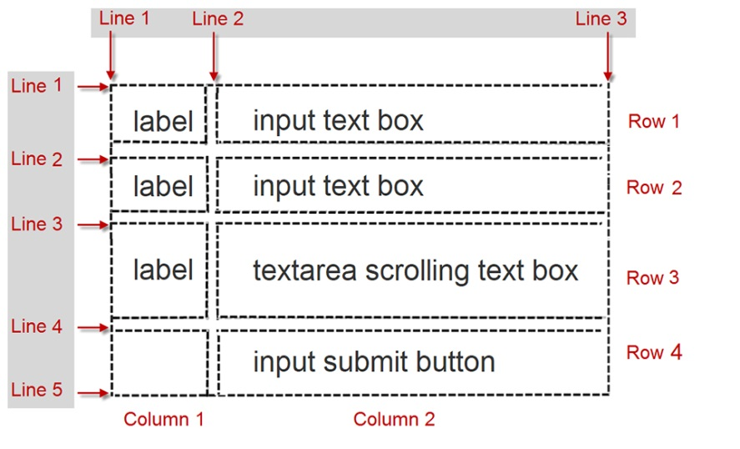

Using C S S Grid Layout to Style a Form
form { display: grid;
grid-template-rows: auto;
grid-template-columns: 6em 1fr;
grid-gap: 1em; gap: 1em;
background-color: #E A E A E A; font-family: Arial, sans-serif;
width: 60%; min-width: 20em; padding: 2em; }
input[type="submit"] { grid-column: 2 / 3;
width: 10em; }

Slide 32
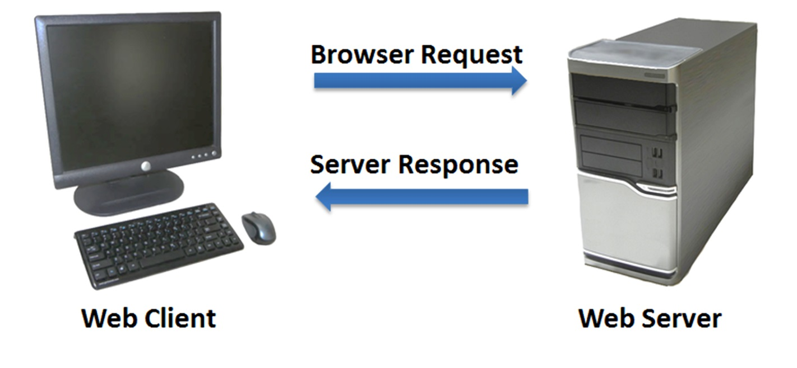
Server-Side Processing
Your web browser requests web pages and their related files from a web server.
The web server locates the files and sends them to your web browser.
The web browser then renders the returned files and displays the requested web pages for you to use.

Slide 33

Server-Side Scripting
One of many technologies in which a server-side script is embedded within a web page document saved with a file extension such as:
  .php (P H P)
  .cfm (Adobe ColdFusion)
  .jsp (Sun JavaServer Pages)
  .aspx (A S P.Net)
Uses direct execution — the script is run either by the web server itself or by an extension module to the web server.

Slide 34
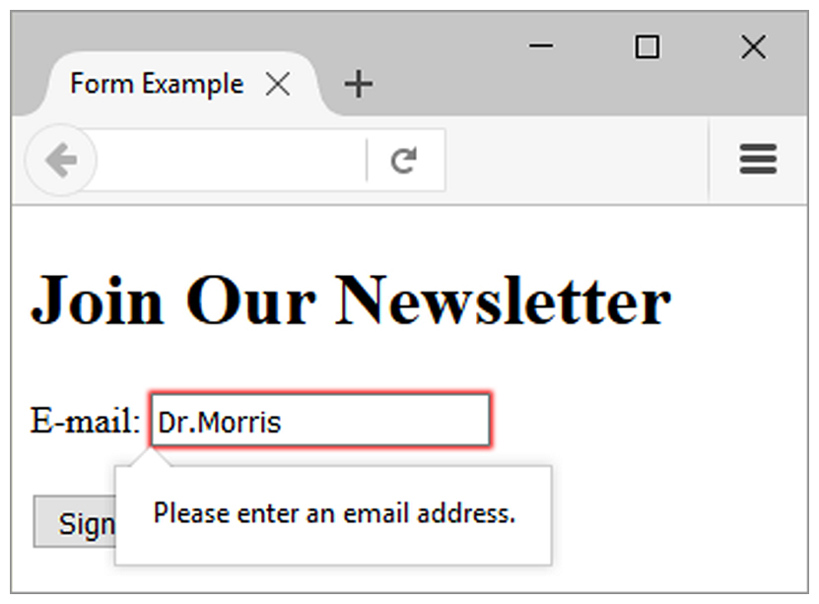
H T M L 5: Email Text Box <input>
Accepts text information in e-mail address format
Common Attributes:
  type="email"
  name
  id
  size
  maxlength
  value
  placeholder
  required

Slide 35
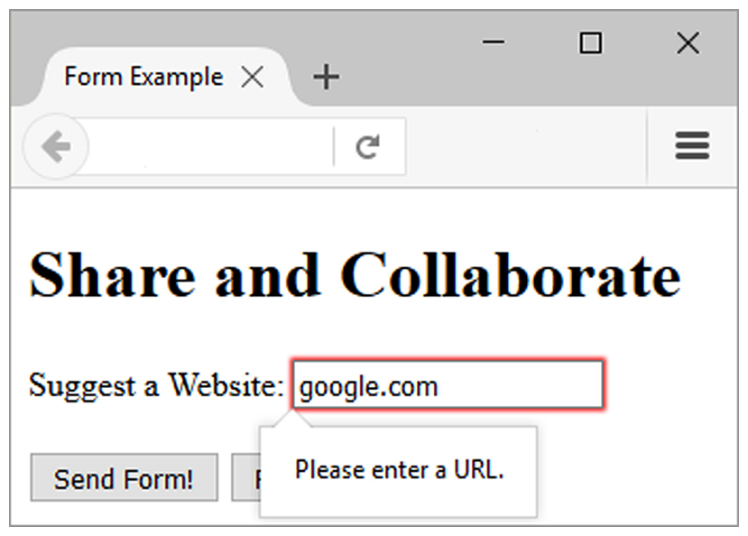
H T M L 5: U R L Text Box <input>
Accepts text information in U R L format
Common Attributes:
  type="url"
  name
  id
  size
  maxlength
  value
  placeholder
  required

Slide 36
H T M L 5: Telephone Number Text Box <input>
Accepts text information in telephone number format
Common Attributes:
  type="tel"
  name
  id
  size
  maxlength
  value
  placeholder
  required

Slide 37
H T M L 5: Search Text Box <input>
Accepts search terms
Common Attributes:
  type="search"
  name
  id
  size
  maxlength
  value
  placeholder
  required

Slide 38
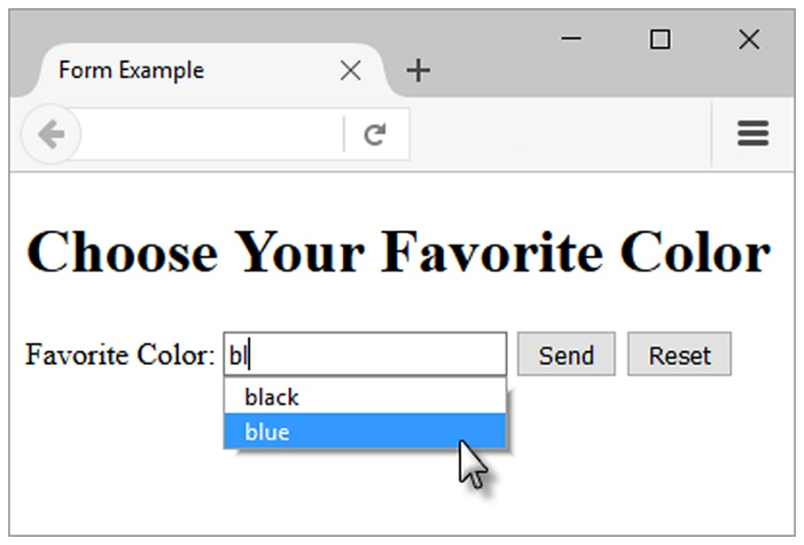
H T M L 5: Datalist Control
<label for="color">Favorite Color:</label>
<input type="text" name="color" id="color" list="colors" >
<datalist id="colors">
<option>red</option>
<option>green</option>
<option>blue</option>
<option>yellow</option>
<option>pink</option>
<option>black</option
</datalist>

Slide 39
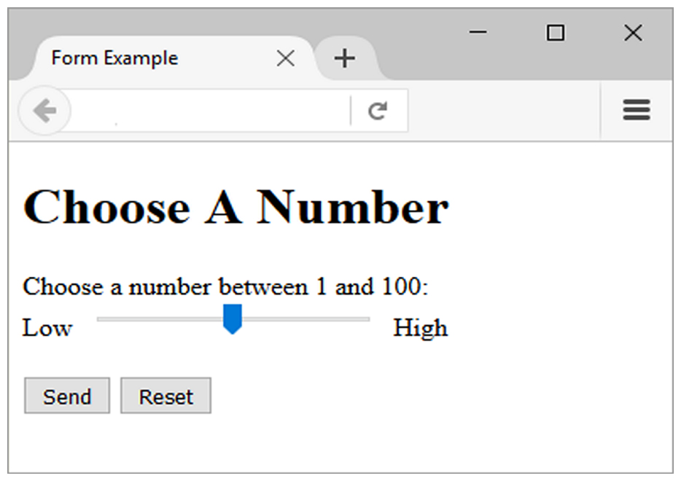
H T M L 5: Slider Control <input>
<label for="myChoice">
Choose a number between 1 and 100:</label><br>
Low <input type="range" name="myChoice" id="myChoice"> High

Slide 40
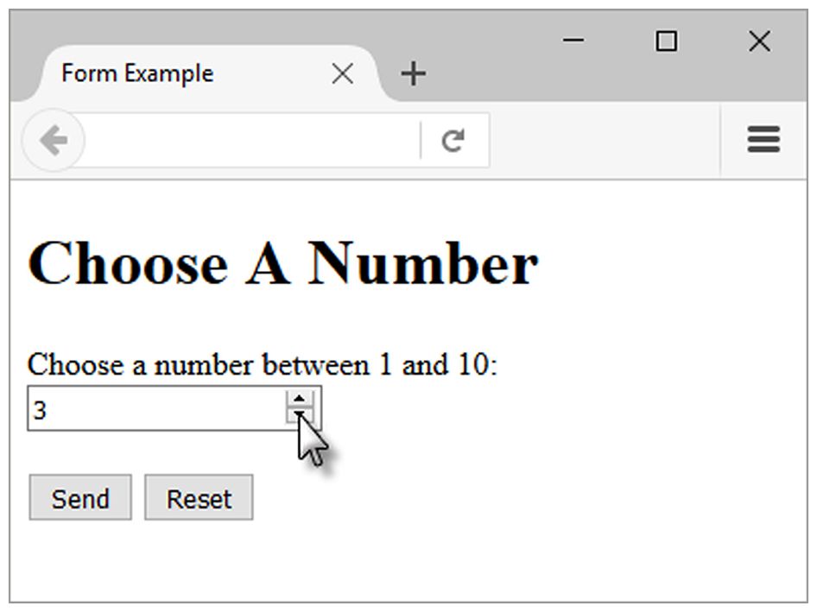
H T M L 5: Spinner Control <input>
<label for="myChoice">
Choose a number between 1 and 10:</label>
<input type="number" name="myChoice" id="myChoice“
min="1" max="10">

Slide 41
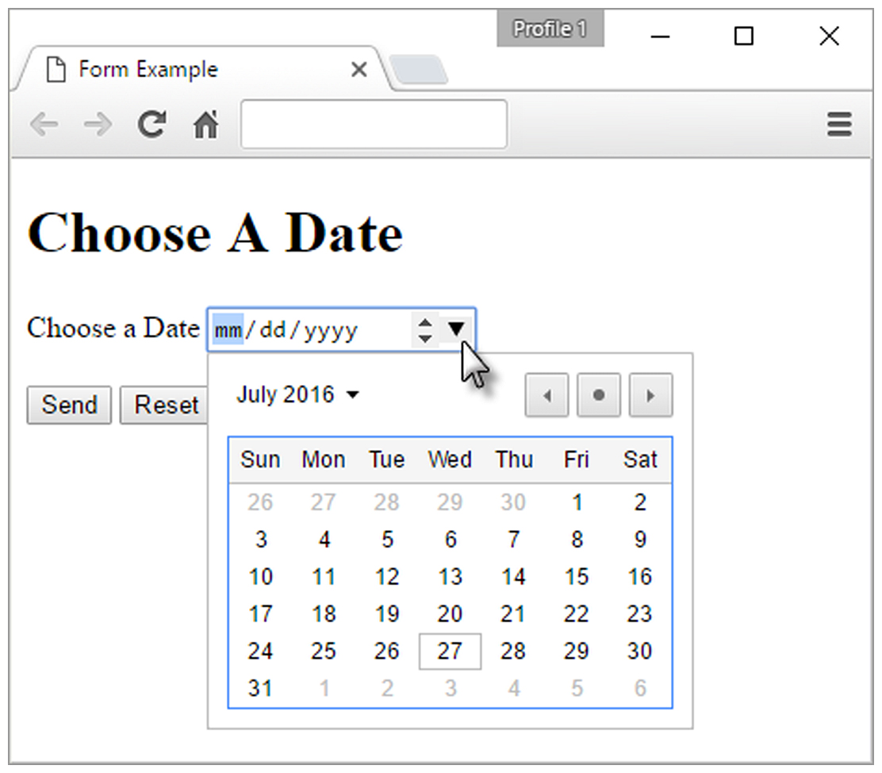
H T M L 5: Calendar Control <input>
<label for="myDate">Choose a Date</label>
<input type="date" name="myDate" id="myDate">

Slide 42
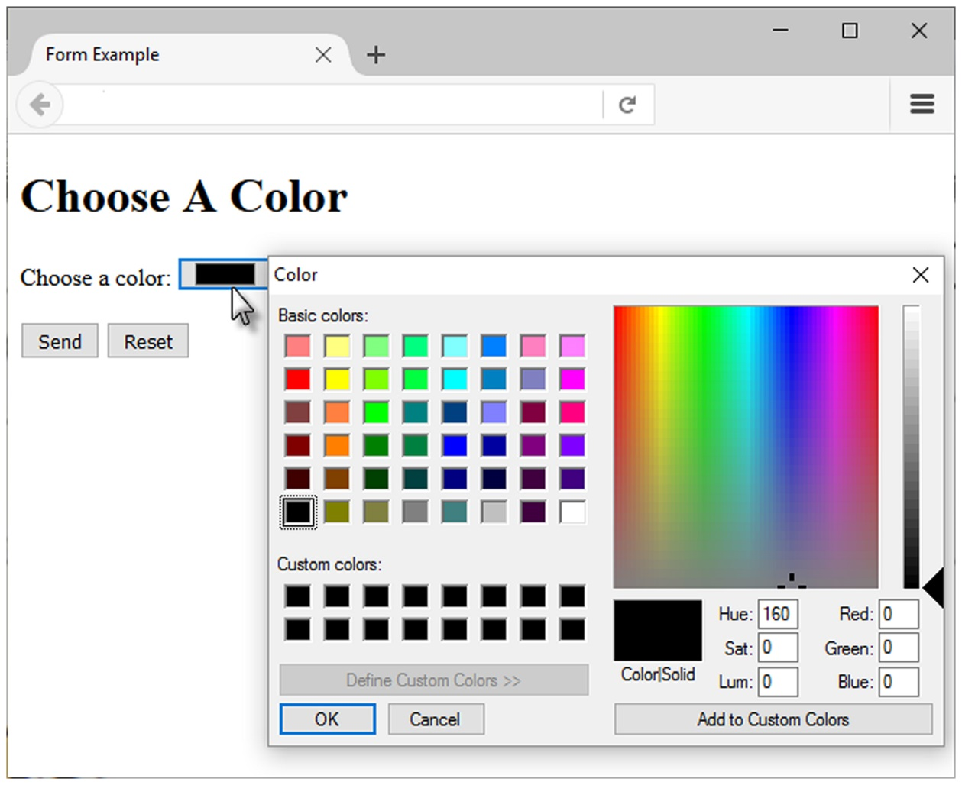
H T M L 5 Color-well Control
<label for="myColor">Choose a color:</label>
<input type="color" name="myColor" id="myColor">

Slide 43
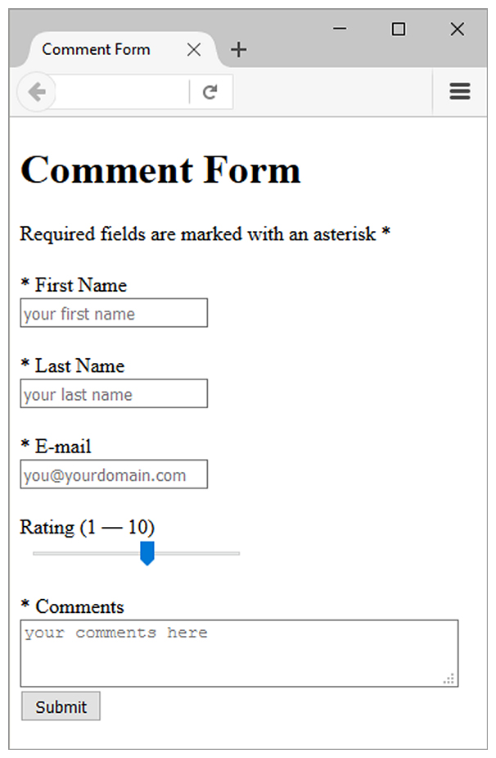
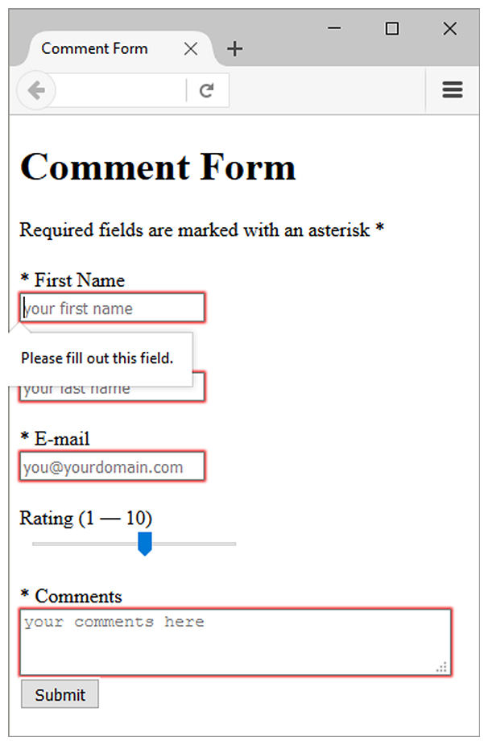
Practice with an H T M L 5 Form
The form display and functioning varies with browser support.

Slide 44
Summary
This chapter introduced the use of forms on web pages.
You learned about how to configure form elements and provide for accessibility.
You learned how to configure a form to access server-side processing.
You also learned about new H T M L 5 form controls and attributes.

Slide 45

Copyright
This work is protected by United States copyright laws and is provided solely for the use of instructors in teaching their courses and assessing student learning. Dissemination or sale of any part of this work (including on the World Wide Web) will destroy the integrity of the work and is not permitted. The work and materials from it should never be made available to students except by instructors using the accompanying text in their classes. All recipients of this work are expected to abide by these restrictions and to honor the intended pedagogical purposes and the needs of other instructors who rely on these materials.

